Slide 1
Chapter 11 Linear Feedback Systems

Slide 2
Outline
Linear Feedback Systems
Applications and Consequences of Feedback
Root Locus Analysis
Nyquist Stability Criterion
Phase/Gain Margins

Slide 3
Open-loop Control vs. Closed-Loop Control with Feedback
§11.1 Linear Feedback Systems
Open-loop control
needs to precisely know the mathematical relationship between the controlling signal and the controlled signal
vulnerable to disturbance
Closed-loop control with feedback
can detect and correct the output deviation promptly
can improve the system transfer linearity and accuracy
can stabilize the unstable systems
http://v.youku.com/v_show/id_XMzQ2MDc5ODYwOA==.html

Slide 4
Feedback in Analog Circuit Design
§11.1 Linear Feedback Systems
Feedback is used in almost all the analog circuits
Negative feedback
reference generation
voltage regulator
active analog filters
common-mode feedback
Pipelined ADC/Successive-Approximation (SAR) ADC
oversampling ADC
Positive feedback: clock generators, oscillators

Slide 5
Reference generation (Bandgap)
§11.1 Linear Feedback Systems
W. Sansen, Analog Design Essentials

Slide 6
Voltage Regulator
§11.1 Linear Feedback Systems

Slide 7
Active Analog Filters
§11.1 Linear Feedback Systems
3rd Order Bessel Low-Pass Filter

Slide 8
Common-Mode Feedback
§11.1 Linear Feedback Systems
W. Sansen, Analog Design Essentials

Slide 9
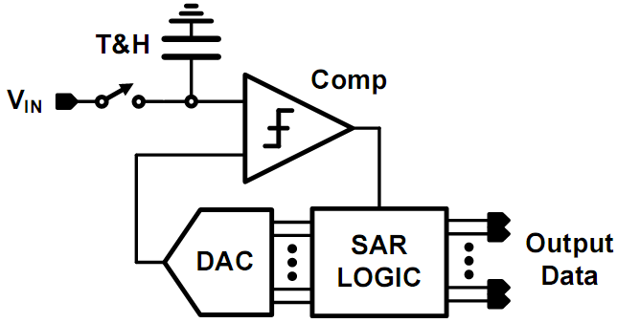
Successive-Approximation (SAR) ADC
§11.1 Linear Feedback Systems

Slide 10
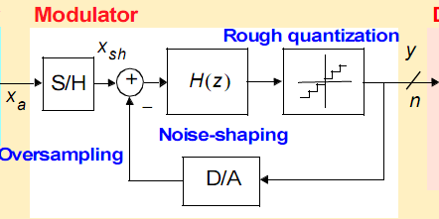
Oversampling ADC
§11.1 Linear Feedback Systems

Slide 11
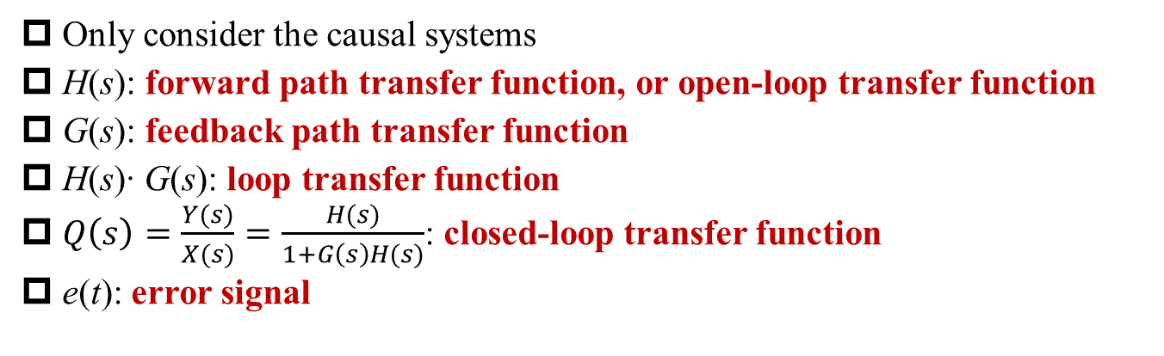
General Configuration of CT LTI Feedback System
§11.1 Linear Feedback Systems
Only consider the causal systems
H(s): forward path transfer function, or open-loop transfer function
G(s): feedback path transfer function
H(s)∙ G(s): loop transfer function
$Q\left(s\right)=\frac{Y(s)}{X(s)}=\frac{H(s)}{1+G\left(s\right)H(s)}$: closed-loop transfer function
e(t): error signal
Q: How to get Q(s)?

Slide 12
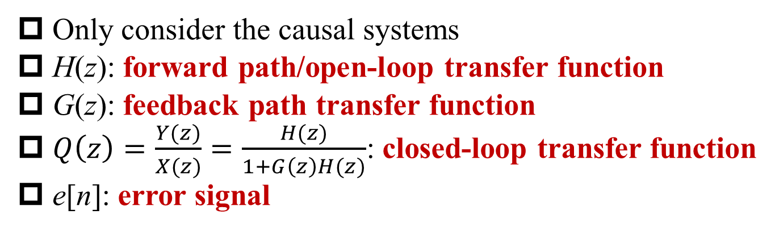
General Configuration of DT LTI Feedback System
§11.1 Linear Feedback Systems
Only consider the causal systems
H(z): forward path/open-loop transfer function
G(z): feedback path transfer function
$Q\left(z\right)=\frac{Y(z)}{X(z)}=\frac{H(z)}{1+G\left(z\right)H(z)}$: closed-loop transfer function
e[n]: error signal

Slide 13
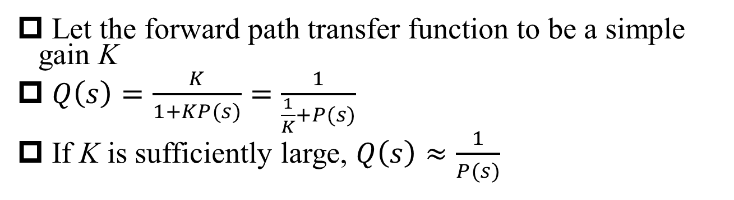
Application of Feedback #1: Inverse System Design
§11.2 Applications and Consequences of Feedback
Let the forward path transfer function to be a simple gain K
$Q\left(s\right)=\frac{K}{1+KP(s)}=\frac{1}{\frac{1}{K}+P(s)}$
If K is sufficiently large, $Q\left(s\right)≈\frac{1}{P(s)}$
Inverse System

Slide 14
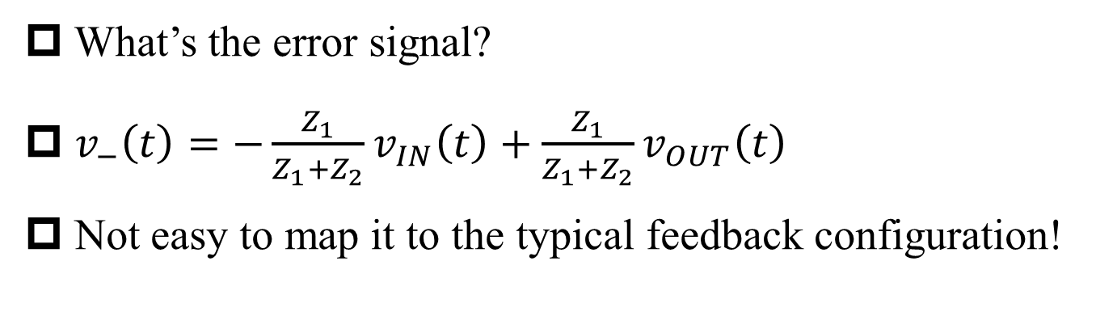
Inverted Feedback with Operational Amplifier
§11.2 Applications and Consequences of Feedback
What’s the error signal?
$v_{−}\left(t\right)=−\frac{Z_{1}}{Z_{1}+Z_{2}}v_{IN}\left(t\right)+\frac{Z_{1}}{Z_{1}+Z_{2}}v_{OUT}\left(t\right)$
Not easy to map it to the typical feedback configuration!

Slide 15
Thévenin Equivalent
§11.2 Applications and Consequences of Feedback

Slide 16
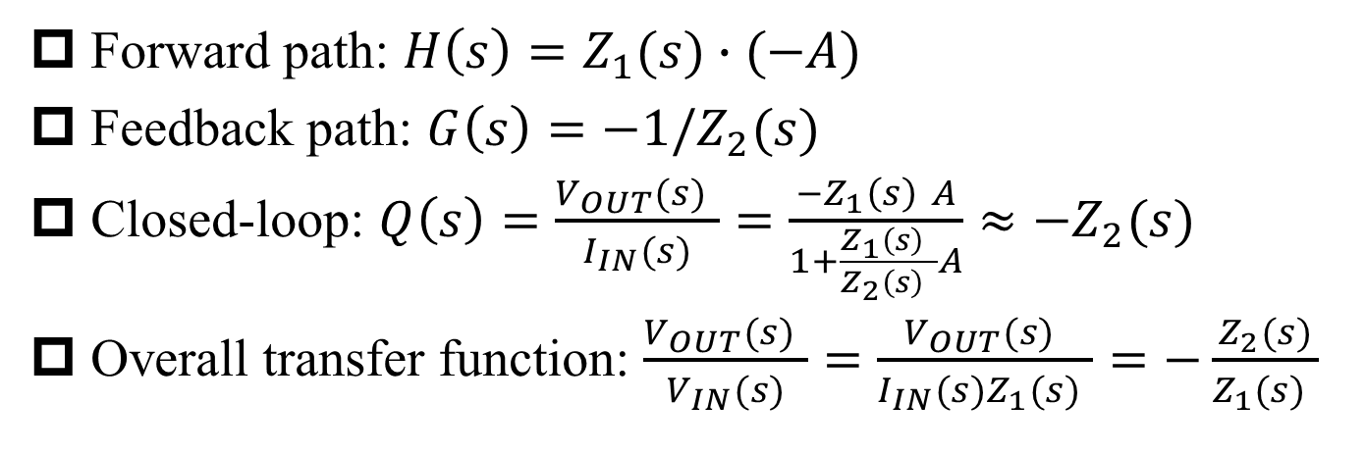
Inverted Feedback with Operational Amplifier (cont’)
§11.2 Applications and Consequences of Feedback
Forward path: $H\left(s\right)=Z_{1}(s)∙(−A)$
Feedback path: $G\left(s\right)=−1/Z_{2}(s)$
Closed-loop: $Q\left(s\right)=\frac{V_{OUT}(s) }{I_{IN}(s)}=\frac{−Z_{1}\left(s\right) A}{1+\frac{Z_{1}\left(s\right) }{Z_{2}\left(s\right) }A}≈−Z_{2}(s)$
Overall transfer function: $\frac{V_{OUT}(s) }{V_{IN}(s)}=\frac{V_{OUT}(s) }{I_{IN}(s)Z_{1}(s) }=−\frac{Z_{2}(s)}{Z_{1}(s) }$

Slide 17
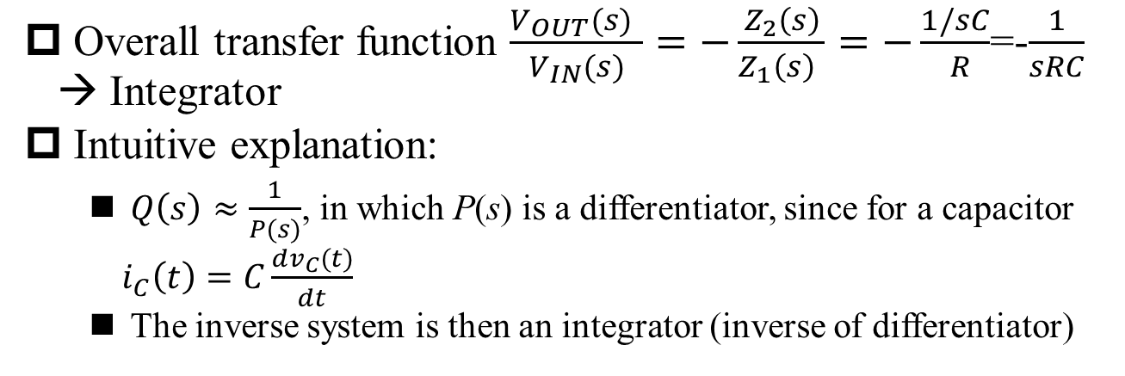
Inverse System Example
§11.2 Applications and Consequences of Feedback
Overall transfer function $\frac{V_{OUT}(s) }{V_{IN}(s)}=−\frac{Z_{2}\left(s\right)}{Z_{1}\left(s\right) }=−\frac{1/sC}{ R}$=-$\frac{1}{sRC}$ → Integrator
Intuitive explanation:
$Q\left(s\right)≈\frac{1}{P(s)}$, in which P(s) is a differentiator, since for a capacitor $i_{C}\left(t\right)=C\frac{dv_{C}(t)}{dt}$
The inverse system is then an integrator (inverse of differentiator)

Slide 18
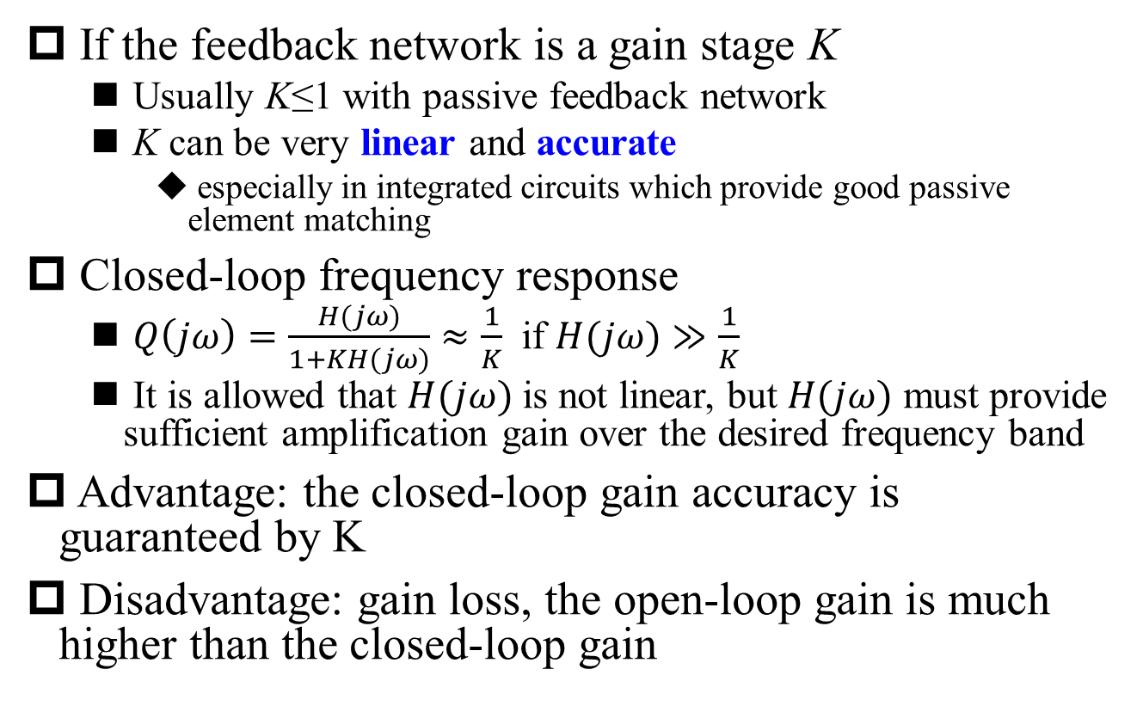
Application of Feedback #2: Compensation for Nonideal Elements
§11.2 Applications and Consequences of Feedback
If the feedback network is a gain stage K
Usually K≤1 with passive feedback network
K can be very linear and accurate
especially in integrated circuits which provide good passive element matching
Closed-loop frequency response
$Q\left(jω\right)=\frac{H(jω)}{1+KH(jω)}≈\frac{1}{K}$ if $H(jω)≫\frac{1}{K}$
It is allowed that $H(jω)$ is not linear, but $H(jω)$ must provide sufficient amplification gain over the desired frequency band
Advantage: the closed-loop gain accuracy is guaranteed by K
Disadvantage: gain loss, the open-loop gain is much higher than the closed-loop gain

Slide 19
Extra Analysis: How the Closed-Loop Gain is Stabilized
§11.2 Applications and Consequences of Feedback
Basic assumptions:
Ideal open-loop gain A_{op}
Open-loop gain error ΔA_{op}
Actual open-loop gain A_{op}’
Relative open-loop gain error:
Loop feedback gain: F
Ideal closed-loop gain:
Actual closed-loop gain:
Relative closed-loop gain error:
Q: What if F has error?

Slide 20
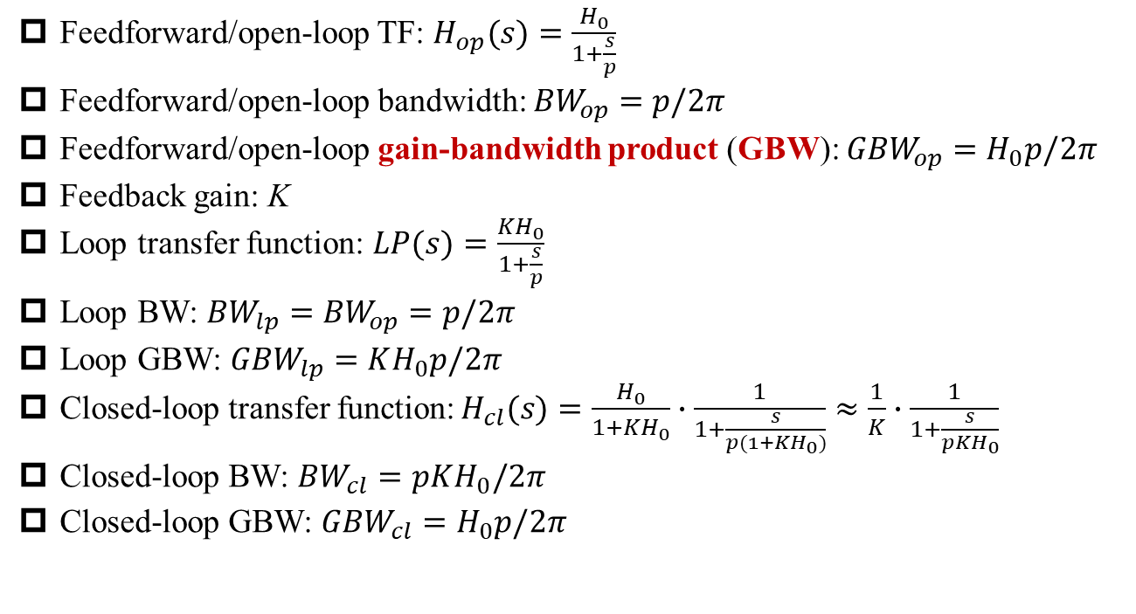
1st Order System with Feedback
§11.2 Applications and Consequences of Feedback
Feedforward/open-loop TF: $H_{op}(s)=\frac{H_{0}}{1+\frac{s}{p}}$
Feedforward/open-loop bandwidth: ${BW}_{op}=p/2π$
Feedforward/open-loop gain-bandwidth product (GBW): ${GBW}_{op}=H_{0}p/2π$
Feedback gain: K
Loop transfer function: $LP(s)=\frac{KH_{0}}{1+\frac{s}{p}}$
Loop BW: ${BW}_{lp}={BW}_{op}=p/2π$
Loop GBW: ${GBW}_{lp}=KH_{0}p/2π$
Closed-loop transfer function:$H_{cl}(s)=\frac{H_{0}}{1+KH_{0}}∙\frac{1}{1+\frac{s}{p(1+KH_{0})}}≈\frac{1}{K}∙\frac{1}{1+\frac{s}{pKH_{0}}}$
Closed-loop BW: ${BW}_{cl}=pKH_{0}/2π$
Closed-loop GBW: ${GBW}_{cl}=H_{0}p/2π$
Gain-Bandwidth Exchange
Q: Bode plot?

Slide 21
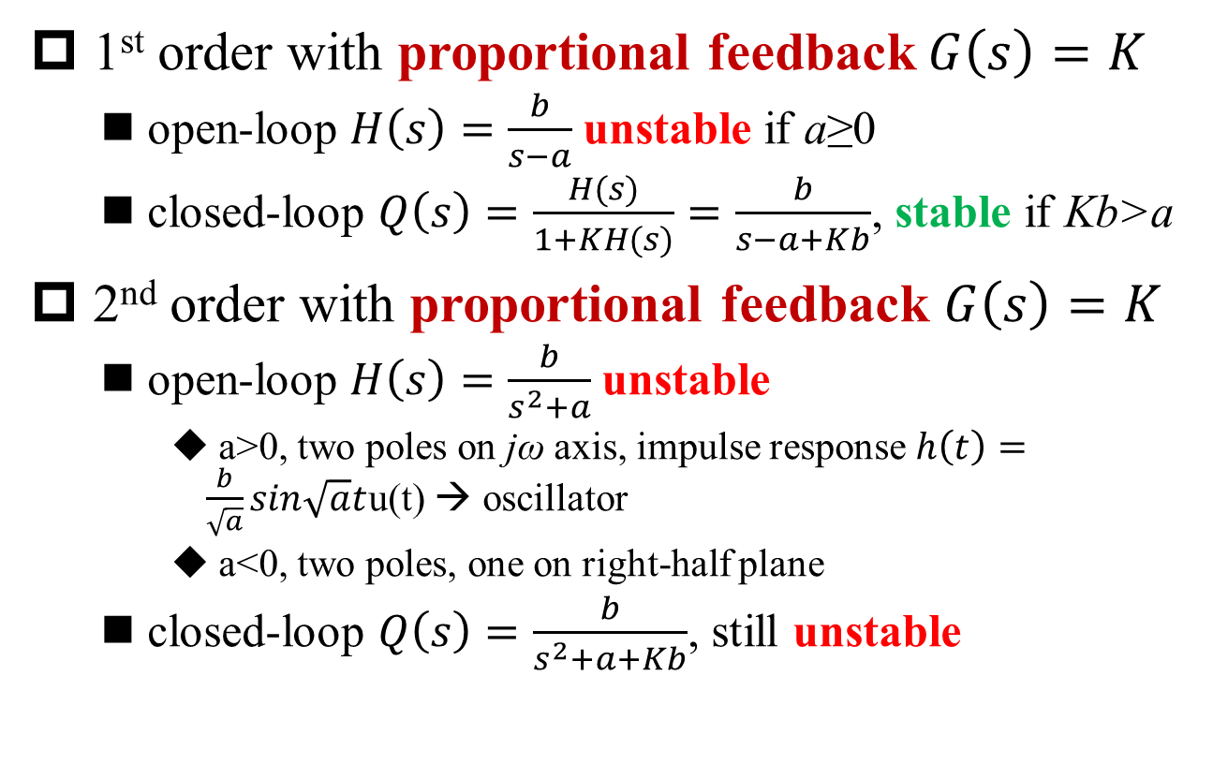
Application of Feedback #3: Stabilization of Unstable Systems
§11.2 Applications and Consequences of Feedback
1st order with proportional feedback$G\left(s\right)=K$
open-loop $H\left(s\right)=\frac{b}{s−a}$ unstable if a≥0
closed-loop $Q\left(s\right)=\frac{H(s)}{1+KH(s)}=\frac{b}{s−a+Kb}$, stable if Kb>a
2nd order with proportional feedback $G\left(s\right)=K$
open-loop $H\left(s\right)=\frac{b}{s^{2}+a}$ unstable
a>0, two poles on jω axis, impulse response $h\left(t\right)=\frac{b}{\sqrt{a}}sin\sqrt{a}t$u(t) → oscillator
a<0, two poles, one on right-half plane
closed-loop $Q\left(s\right)=\frac{b}{s^{2}+a+Kb}$, still unstable

Slide 22
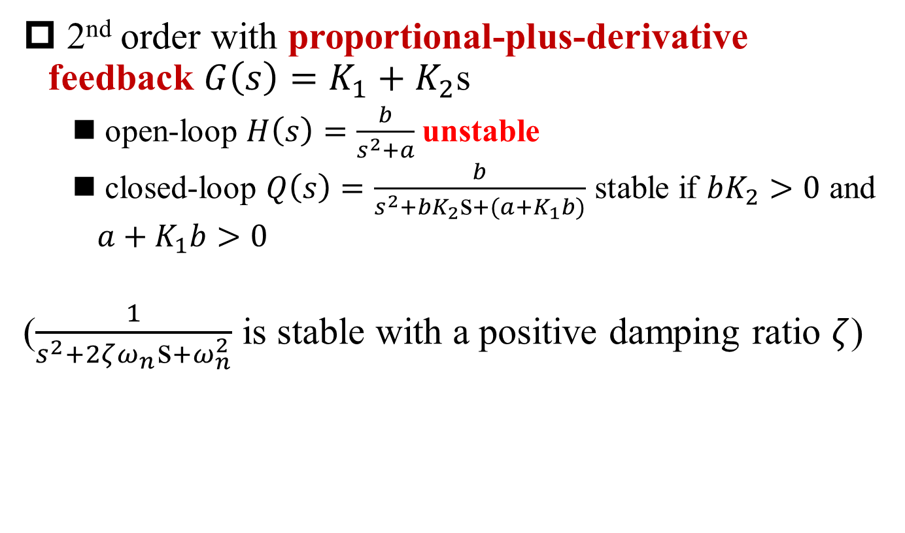
Application of Feedback #3: Stabilization of Unstable Systems (cont’)
§11.2 Applications and Consequences of Feedback
2nd order with proportional-plus-derivative feedback $G\left(s\right)=K_{1}+K_{2}$s
open-loop $H\left(s\right)=\frac{b}{s^{2}+a}$ unstable
closed-loop $Q\left(s\right)=\frac{b}{s^{2}+bK_{2}\text{s}+(a+K_{1}b)}$ stable if $bK_{2}>0$ and $a+K_{1}b>0$
($\frac{1}{s^{2}+2ζω_{n}\text{s}+ω_{n}^{2}}$ is stable with a positive damping ratio $ζ$)

Slide 23
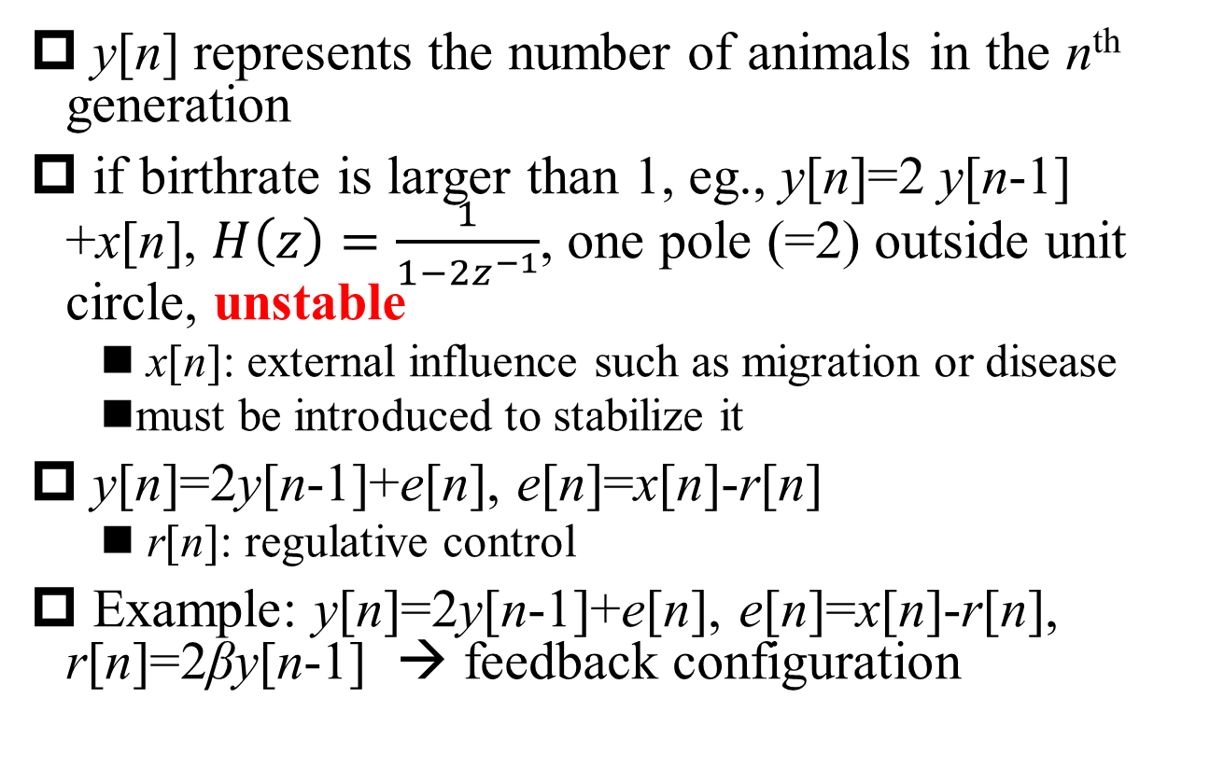
Stabilization of Unstable DT System
§11.2 Applications and Consequences of Feedback
y[n] represents the number of animals in the n^{th} generation
if birthrate is larger than 1, eg., y[n]=2 y[n-1] +x[n], $H\left(z\right)=\frac{1}{1−2z^{−1}}$, one pole (=2) outside unit circle, unstable
x[n]: external influence such as migration or disease
must be introduced to stabilize it
y[n]=2y[n-1]+e[n], e[n]=x[n]-r[n]
r[n]: regulative control
Example: y[n]=2y[n-1]+e[n], e[n]=x[n]-r[n], r[n]=2βy[n-1] → feedback configuration

Slide 24
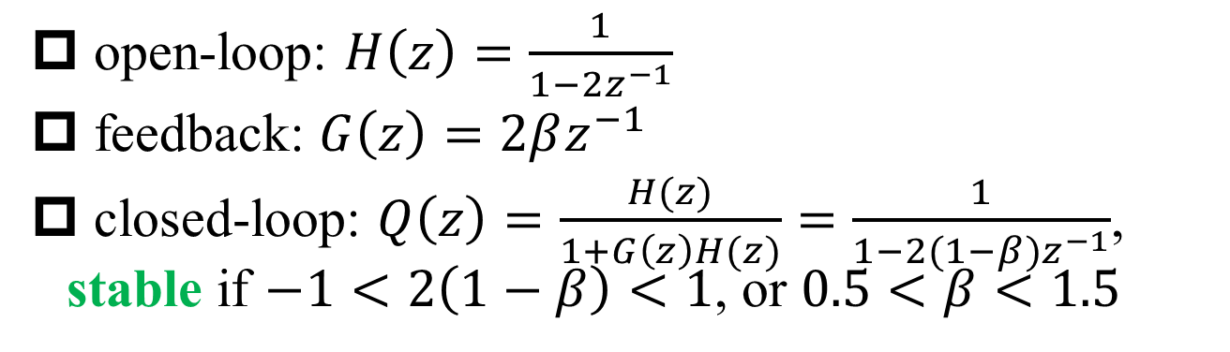
Stabilization of Unstable DT System (cont’)
§11.2 Applications and Consequences of Feedback
open-loop: $H\left(z\right)=\frac{1}{1−2z^{−1}}$
feedback: $G\left(z\right)=2βz^{−1}$
closed-loop: $Q\left(z\right)=\frac{H(z)}{1+G\left(z\right)H(z)}=\frac{1}{1−2(1−β)z^{−1}}$, stable if $−1<2\left(1−β\right)<1$, or $0.5<β<1.5$

Slide 25
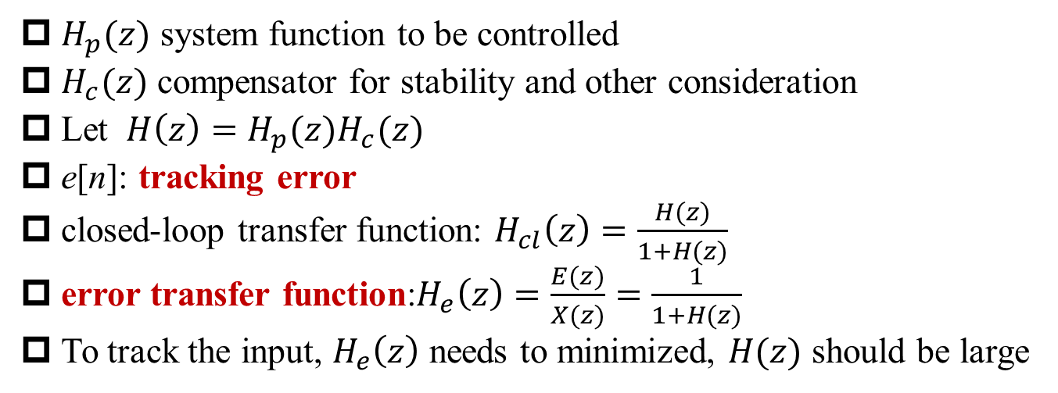
Tracking Systems with Feedback
§11.2 Applications and Consequences of Feedback
$H_{p}(z)$ system function to be controlled
$H_{c}(z)$ compensator for stability and other consideration
Let ${ H\left(z\right)=H_{p}(z)H}_{c}(z)$
e[n]: tracking error
closed-loop transfer function: $H_{cl}\left(z\right)=\frac{H(z)}{1+H(z)}$
error transfer function:$H_{e}\left(z\right)=\frac{E(z)}{X(z)}=\frac{1}{1+H(z)}$
To track the input, $H_{e}\left(z\right)$ needs to minimized, $H(z)$ should be large
Q: How to prove?

Slide 26
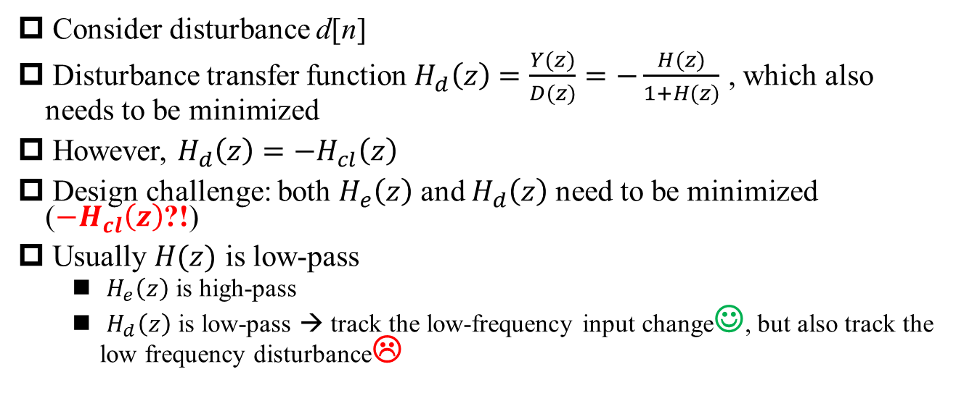
Tracking Systems with Feedback (Cont’)
§11.2 Applications and Consequences of Feedback
Consider disturbance d[n]
Disturbance transfer function $H_{d}\left(z\right)=\frac{Y(z)}{D(z)}=−\frac{H(z)}{1+H(z)}$ , which also needs to be minimized
However, ${H_{d}\left(z\right)=−H}_{cl}\left(z\right)$
Design challenge: both $H_{e}\left(z\right)$ and $H_{d}\left(z\right)$ need to be minimized (${−H}_{cl}\left(z\right)$?!)
Usually $H(z)$ is low-pass
$H_{e}\left(z\right)$ is high-pass
$H_{d}\left(z\right)$ is low-pass → track the low-frequency input change☺, but also track the low frequency disturbance☹

Slide 27
A Typical Tracking System: Phase-Locked Loop (PLL)
§11.2 Applications and Consequences of Feedback
VCO
Ref
LO
PD
Loop Filter
Phase-Locked Loop
1/N

Slide 28
Functional Blocks in PLL
§11.2 Applications and Consequences of Feedback
VCO
Ref
LO
PD
Loop Filter
Phase-Locked Loop
1/N
Phase detector (PD): find difference between phase of two signals
Loop filter: provide appropriate control voltage for voltage-controlled oscillator (VCO)
VCO: generate signals with phase determined by the control voltage
Divide-by-N: LO phase changes N times faster than Ref phase

Slide 29
Charge Pump PLL
§11.2 Applications and Consequences of Feedback
The charge pump PLL is one of the most popular PLL structures since 1980s
Featured with a digital phase detector and a charge pump
Advantages
Fast lock and tracking
No false lock
f_{i}
Phase
Detector
Charge
Pump
Loop
Filter
f_{o}
VCO
f_{o}
N-Divider

Slide 30

Modeling Charge Pump PLL
§11.2 Applications and Consequences of Feedback
I_{p}
V_{C}
C1
R
f_{i}
Phase
Detector
Charge
Pump
Loop
Filter
f_{o}
VCO
f_{o}
N-Divider
$$\frac{1}{N}$$

Slide 31
2nd Order PLL Transfer Function
§11.2 Applications and Consequences of Feedback
Using a 1st order LPF: Active PI type
Open-loop transfer function
Closed-loop transfer function

Slide 32
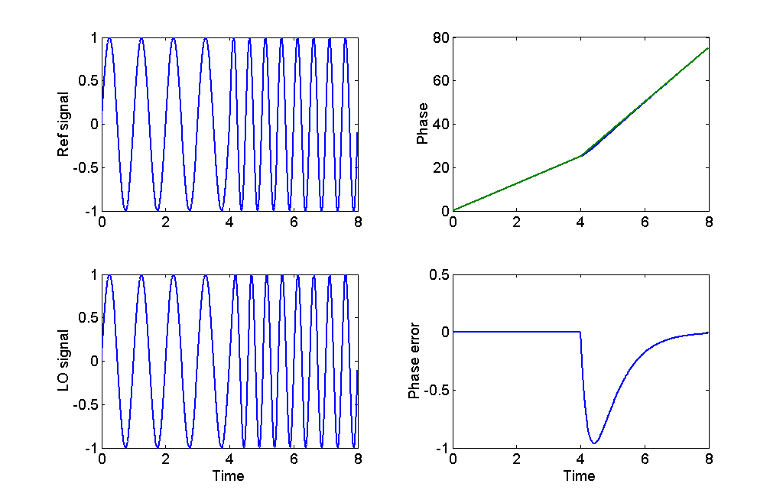
Transient Response of PLL (1)
§11.2 Applications and Consequences of Feedback
Transient response with frequency step (phase ramp)

Slide 33
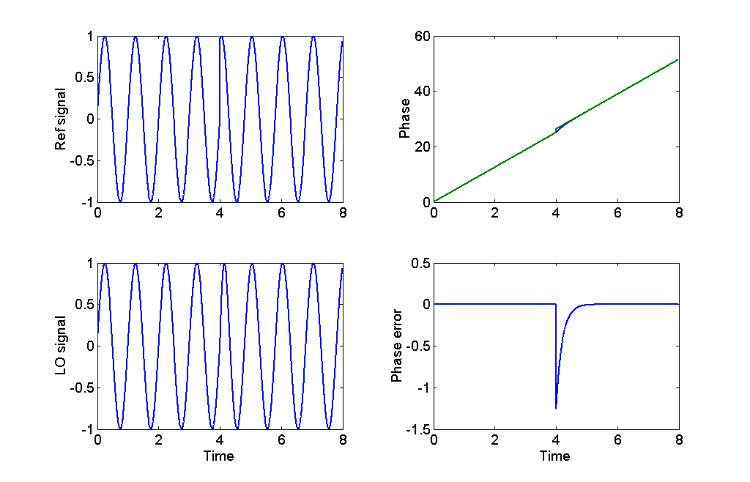
Transient Response of PLL (2)
§11.2 Applications and Consequences of Feedback
Transient response with phase jump/step

Slide 34
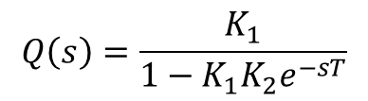
Destabilization Caused by Feedback
§11.2 Applications and Consequences of Feedback
Destabilization: negative feedback → positive feedback
Example: self-excitation of audio system
e^{-sT} is the system function of delay network
unstable if K₁K₂>1
$$Q\left(s\right)=\frac{K_{1}}{1−K_{1}K_{2}e^{−sT}}$$

Slide 35
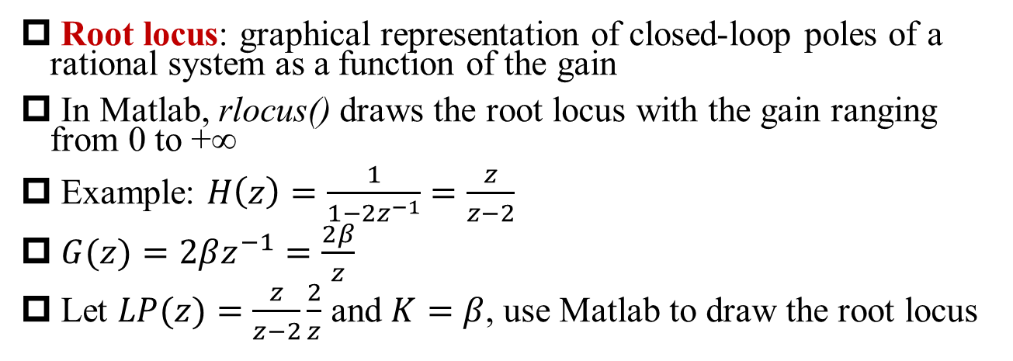


Root Locus
§11.3 Root-locus Analysis
Root locus: graphical representation of closed-loop poles of a rational system as a function of the gain
In Matlab, rlocus() draws the root locus with the gain ranging from 0 to +∞
Example: $H\left(z\right)=\frac{1}{1−2z^{−1}}=\frac{z}{z−2}$
$G(z)=2βz^{−1}=\frac{2β}{z}$
Let $LP(z)=\frac{z}{z−2}\frac{2}{z}$ and $K=β$, use Matlab to draw the root locus
Q: Replace z by s?
A: No difference in root locus
$β$>0
$β<$0

Slide 36
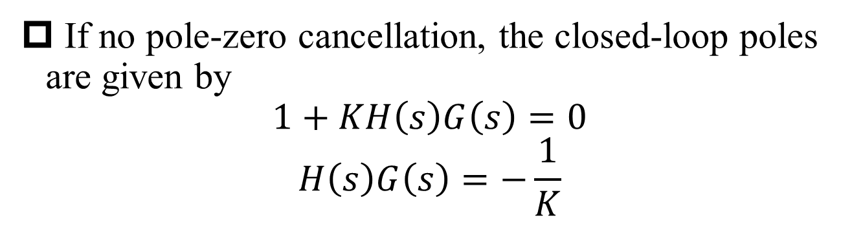
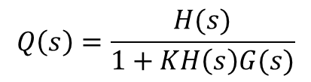
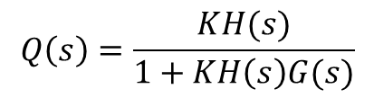
Equation for Closed-Loop Poles
§11.3 Root-locus Analysis
$$Q\left(s\right)=\frac{KH(s)}{1+KH\left(s\right)G(s)}$$
$$Q\left(s\right)=\frac{H(s)}{1+KH\left(s\right)G(s)}$$
If no pole-zero cancellation, the closed-loop poles are given by
$$1+KH\left(s\right)G\left(s\right)=0$$
$$H\left(s\right)G\left(s\right)=−\frac{1}{K}$$

Slide 37
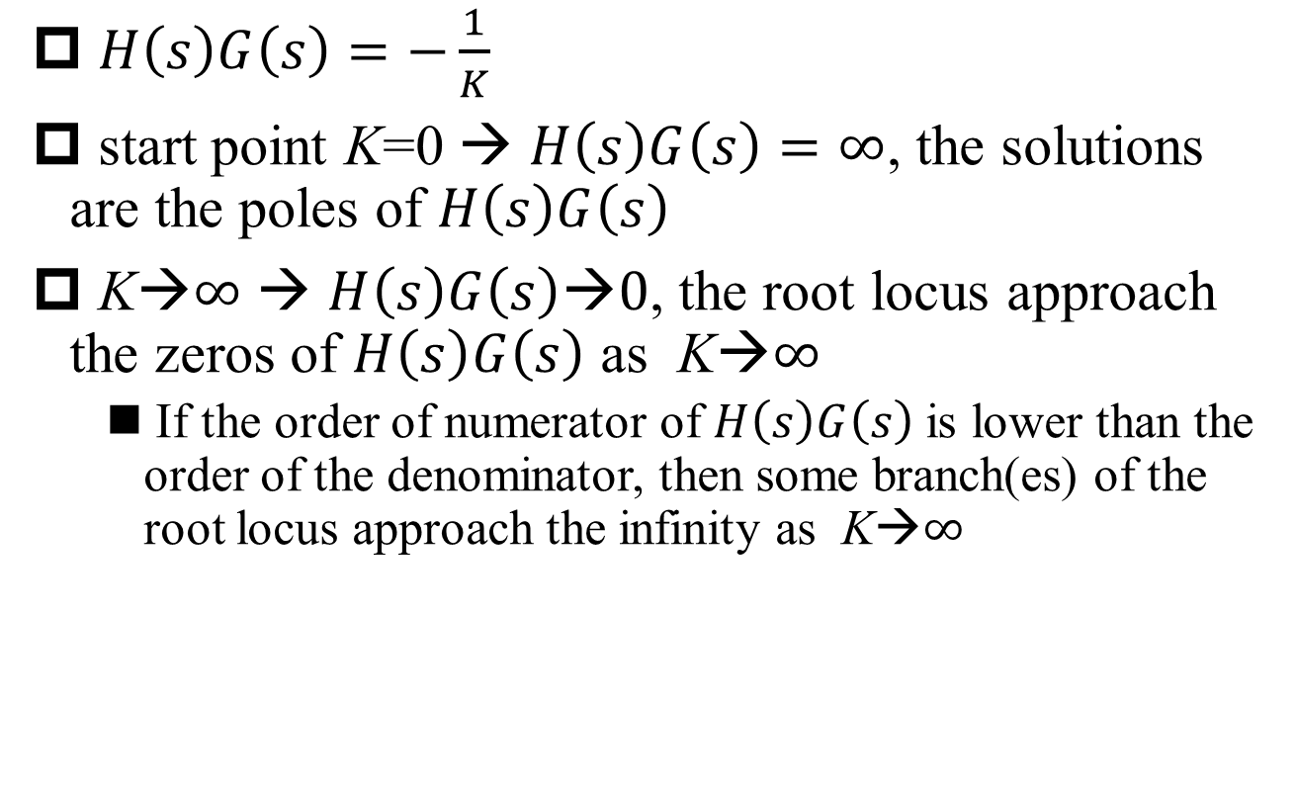
End Points of Root Locus
§11.3 Root-locus Analysis
$H\left(s\right)G\left(s\right)=−\frac{1}{K}$
start point K=0 → $H\left(s\right)G\left(s\right)=∞$, the solutions are the poles of $H\left(s\right)G\left(s\right)$
K→$∞$ → $H\left(s\right)G\left(s\right)\text{→}0$, the root locus approach the zeros of $H\left(s\right)G\left(s\right)$ as K→$∞$
If the order of numerator of $H\left(s\right)G\left(s\right)$ is lower than the order of the denominator, then some branch(es) of the root locus approach the infinity as K→$∞$

Slide 38
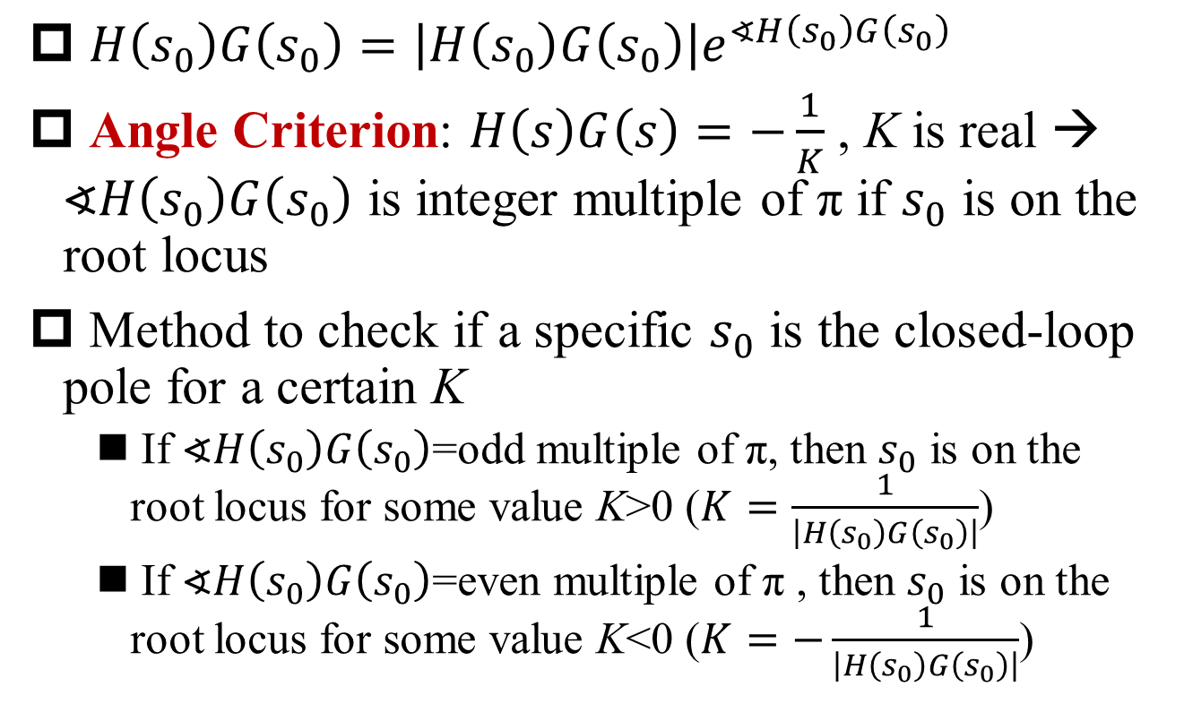
Angle Criterion
§11.3 Root-locus Analysis
$H\left(s_{0}\right)G\left(s_{0}\right)=\left|H\left(s_{0}\right)G\left(s_{0}\right)\right|e^{∢H\left(s_{0}\right)G\left(s_{0}\right)}$
Angle Criterion: $H\left(s\right)G\left(s\right)=−\frac{1}{K}$ , K is real → $∢H\left(s_{0}\right)G\left(s_{0}\right)$ is integer multiple of π if $s_{0}$ is on the root locus
Method to check if a specific $s_{0}$ is the closed-loop pole for a certain K
If $∢H\left(s_{0}\right)G\left(s_{0}\right)$=odd multiple of π, then $s_{0}$ is on the root locus for some value K>0 ($K=\frac{1}{\left|H\left(s_{0}\right)G\left(s_{0}\right)\right|}$)
If $∢H\left(s_{0}\right)G\left(s_{0}\right)$=even multiple of π , then $s_{0}$ is on the root locus for some value K<0 ($K=−\frac{1}{\left|H\left(s_{0}\right)G\left(s_{0}\right)\right|}$)

Slide 39
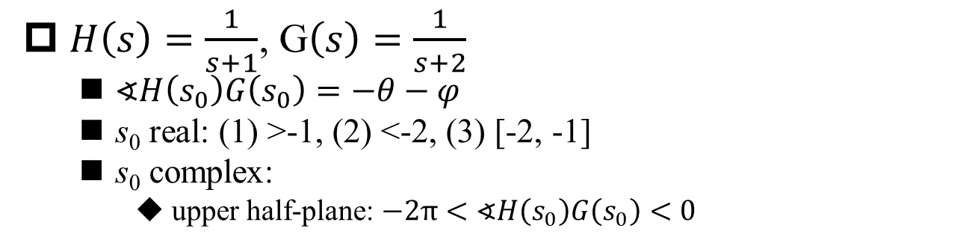


Example to Use Angle Criterion
§11.3 Root-locus Analysis
$H\left(s\right)=\frac{1}{s+1}$, G$\left(s\right)=\frac{1}{s+2}$
$∢H\left(s_{0}\right)G\left(s_{0}\right)=−θ−φ$
s₀ real: (1) >-1, (2) <-2, (3) [-2, -1]
s₀ complex:
upper half-plane: $−2π<∢H\left(s_{0}\right)G\left(s_{0}\right)<0$
$K>$0
$K<$0

Slide 40
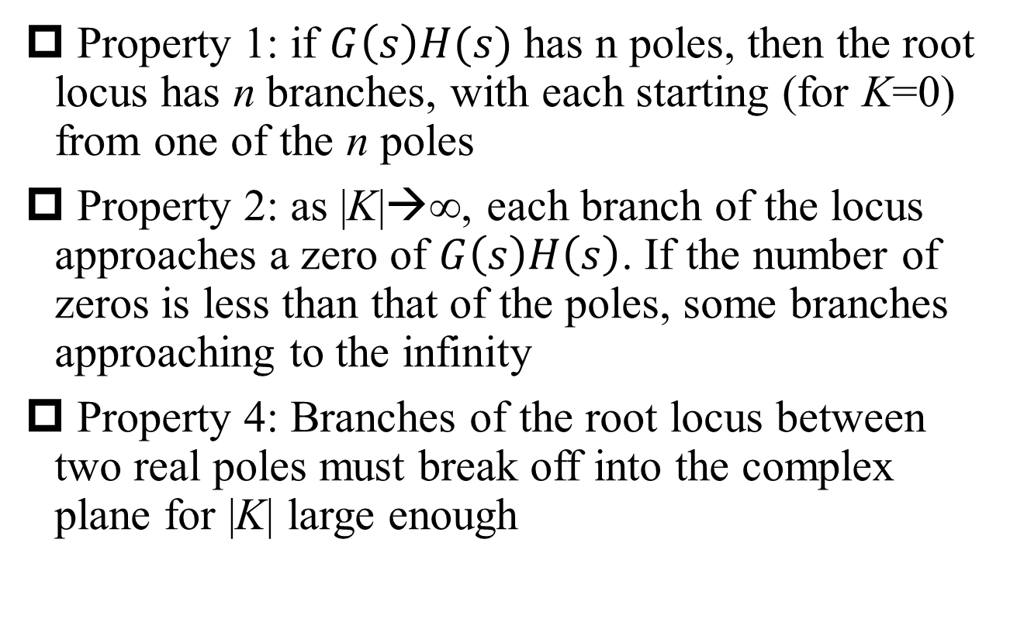
Properties of Root Locus
§11.3 Root-locus Analysis
Property 1: if $G\left(s\right)H(s)$ has n poles, then the root locus has n branches, with each starting (for K=0) from one of the n poles
Property 2: as |K|→∞, each branch of the locus approaches a zero of $G\left(s\right)H\left(s\right)$. If the number of zeros is less than that of the poles, some branches approaching to the infinity
Property 4: Branches of the root locus between two real poles must break off into the complex plane for |K| large enough

Slide 41
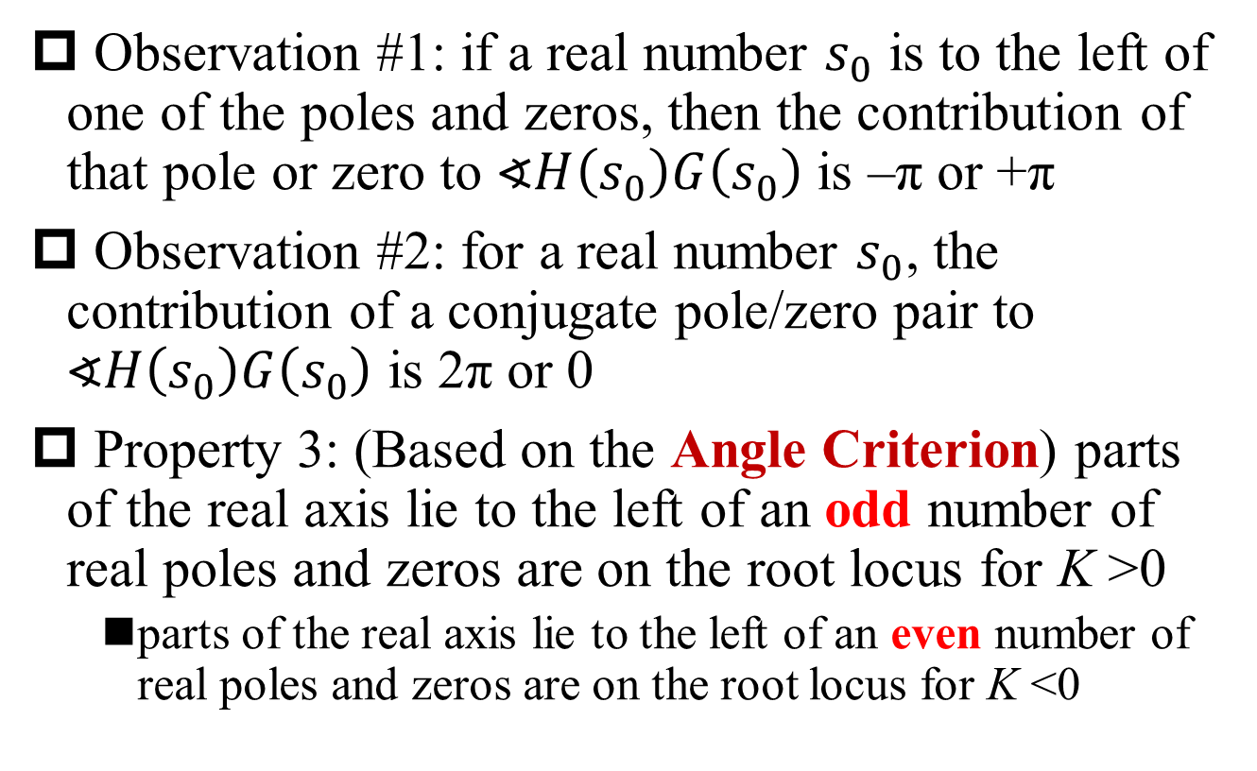
Properties of Root Locus (Cont’)
§11.3 Root-locus Analysis
Observation #1: if a real number $s_{0}$ is to the left of one of the poles and zeros, then the contribution of that pole or zero to $∢H\left(s_{0}\right)G\left(s_{0}\right)$ is –π or +π
Observation #2: for a real number $s_{0}$, the contribution of a conjugate pole/zero pair to $∢H\left(s_{0}\right)G\left(s_{0}\right)$ is 2π or 0
Property 3: (Based on the Angle Criterion) parts of the real axis lie to the left of an odd number of real poles and zeros are on the root locus for K >0
parts of the real axis lie to the left of an even number of real poles and zeros are on the root locus for K <0

Slide 42

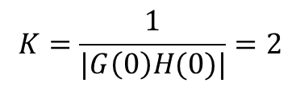
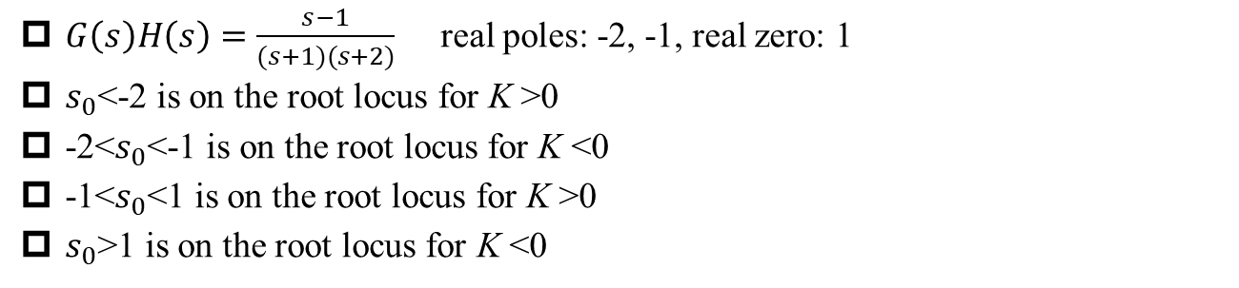



Example (1) of Root Locus Properties
§11.3 Root-locus Analysis
$G\left(s\right)H\left(s\right)=\frac{s−1}{(s+1)(s+2)}$ real poles: -2, -1, real zero: 1
$s_{0}$<-2 is on the root locus for K >0
-2<$s_{0}$<-1 is on the root locus for K <0
-1<$s_{0}$<1 is on the root locus for K >0
$s_{0}$>1 is on the root locus for K <0
$$K=\frac{1}{|G\left(0\right)H(0)|}=2$$
$K>$0
$K<$0
$0<K<2$ stable
Q: $s=?$ K?

Slide 43
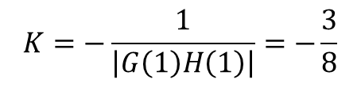
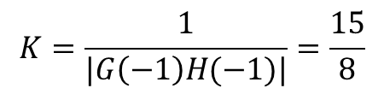
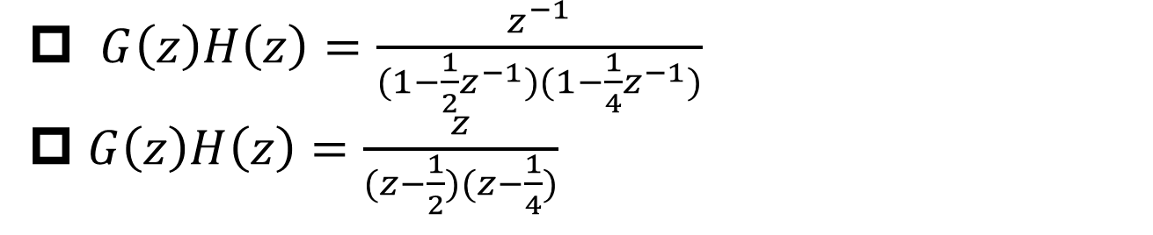



Example (2) of Root Locus Properties
§11.3 Root-locus Analysis
$G\left(z\right)H\left(z\right)=\frac{z^{−1}}{(1−\frac{1}{2}z^{−1})(1−\frac{1}{4}z^{−1})}$
$G\left(z\right)H\left(z\right)=\frac{z}{(z−\frac{1}{2})(z−\frac{1}{4})}$
$K>$0
$$K=\frac{1}{|G\left(−1\right)H(−1)|}=\frac{15}{8}$$
$K$<0
$$K=−\frac{1}{\left|G\left(1\right)H\left(1\right)\right|}=−\frac{3}{8}$$
For stability: $−\frac{3}{8}<K<\frac{15}{8}$

Slide 44
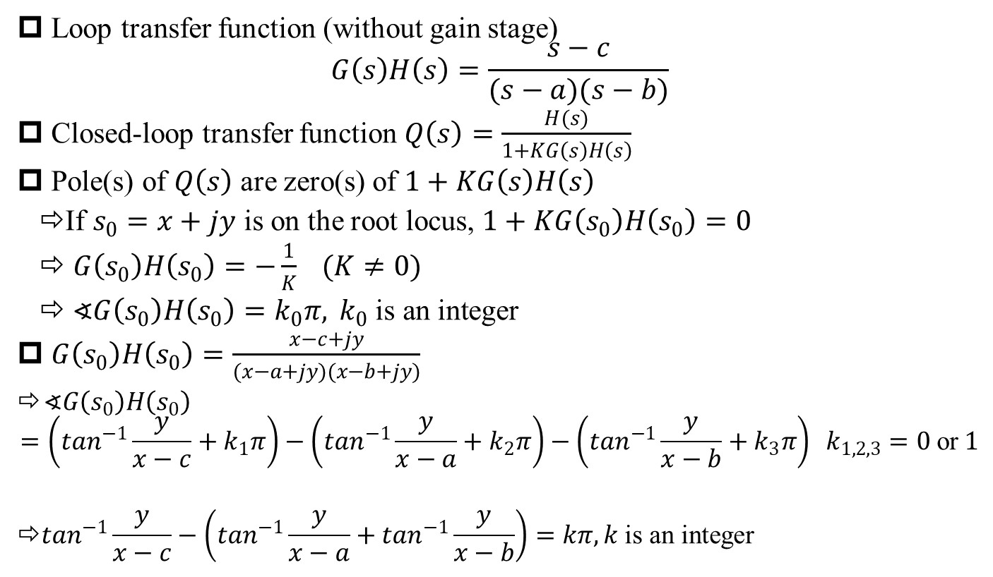
Root locus of 2nd-order loop*
§11.3 Root-locus Analysis
Loop transfer function (without gain stage)
$$G\left(s\right)H\left(s\right)=\frac{s−c}{(s−a)(s−b)}$$
Closed-loop transfer function $Q\left(s\right)=\frac{H(s)}{1+KG\left(s\right)H\left(s\right)}$
Pole(s) of $Q\left(s\right)$ are zero(s) of $1+KG\left(s\right)H\left(s\right)$
⇨If $s_{0}=x+jy$ is on the root locus, $1+KG\left(s_{0}\right)H\left(s_{0}\right)=0$
⇨ $G\left(s_{0}\right)H\left(s_{0}\right)=−\frac{1}{K} (K≠0)$
⇨ $∢G\left(s_{0}\right)H\left(s_{0}\right)=k_{0}π, { k}_{0} \text{is} \text{an} \text{integer}$
$G\left(s_{0}\right)H\left(s_{0}\right)=\frac{x−c+jy}{(x−a+jy)(x−b+jy)}$
$∢G\left(s_{0}\right)H\left(s_{0}\right)$
$$=\left(\tan^{−1}\frac{y}{x−c}+k_{1}π\right)−\left(\tan^{−1}\frac{y}{x−a}+k_{2}π\right)−\left(\tan^{−1}\frac{y}{x−b}+k_{3}π\right) k_{1,2,3}=0 \text{or} 1$$
$$\text{⇨}\tan^{−1}\frac{y}{x−c}−\left(\tan^{−1}\frac{y}{x−a}+\tan^{−1}\frac{y}{x−b}\right)=kπ, k \text{is} \text{an} \text{integer}$$

Slide 45
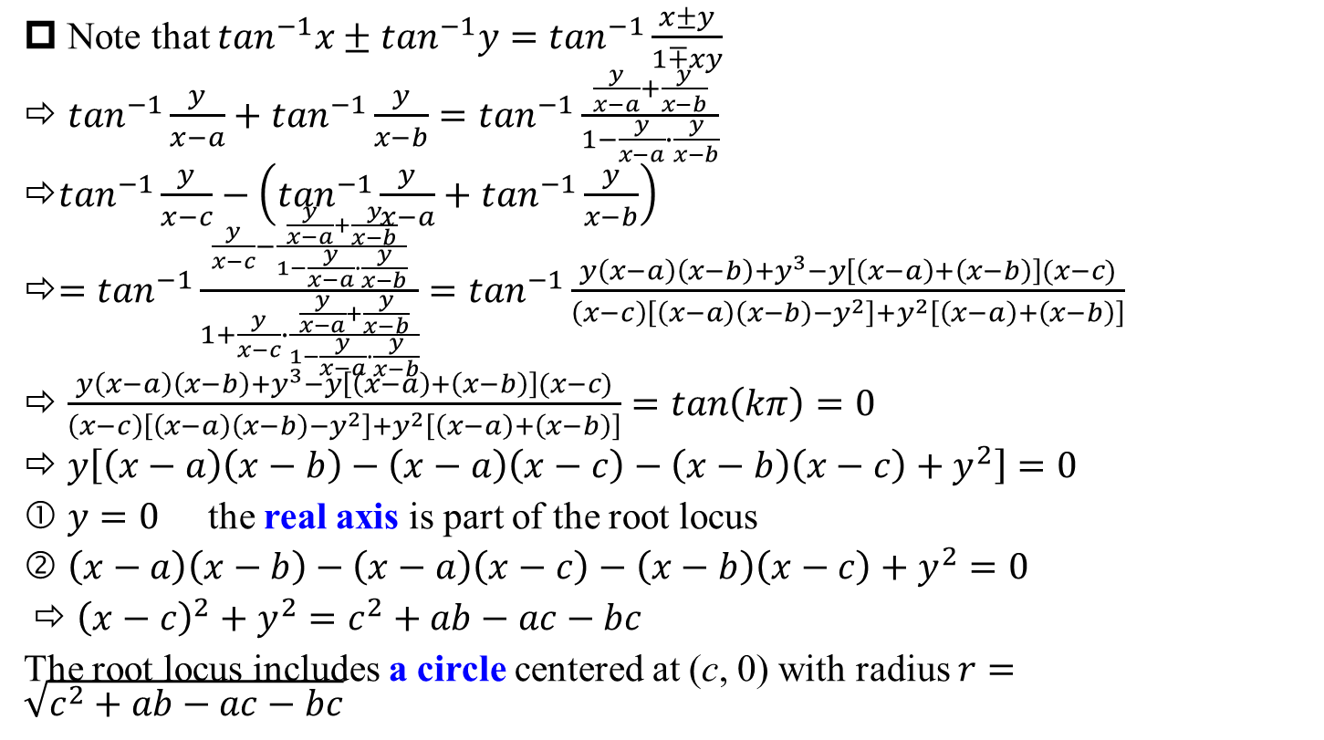
Root locus of 2nd-order loop (cont’)
§11.3 Root-locus Analysis
Note that $\tan^{−1}x±\tan^{−1}y=\tan^{−1}\frac{x±y}{1∓xy}$
⇨ $\tan^{−1}\frac{y}{x−a}+\tan^{−1}\frac{y}{x−b}=\tan^{−1}\frac{\frac{y}{x−a}+\frac{y}{x−b}}{1−\frac{y}{x−a}∙\frac{y}{x−b}}$
$\tan^{−1}\frac{y}{x−c}−\left(\tan^{−1}\frac{y}{x−a}+\tan^{−1}\frac{y}{x−b}\right)$
$=\tan^{−1}\frac{\frac{y}{x−c}−\frac{\frac{y}{x−a}+\frac{y}{x−b}}{1−\frac{y}{x−a}∙\frac{y}{x−b}}}{1+\frac{y}{x−c}∙\frac{\frac{y}{x−a}+\frac{y}{x−b}}{1−\frac{y}{x−a}∙\frac{y}{x−b}}}=\tan^{−1}\frac{y\left(x−a\right)\left(x−b\right)+y^{3}−y\left[\left(x−a\right)+\left(x−b\right)\right](x−c)}{\left(x−c\right)\left[\left(x−a\right)\left(x−b\right)−y^{2}\right]+y^{2}\left[\left(x−a\right)+\left(x−b\right)\right]}$
⇨ $\frac{y\left(x−a\right)\left(x−b\right)+y^{3}−y\left[\left(x−a\right)+\left(x−b\right)\right](x−c)}{\left(x−c\right)\left[\left(x−a\right)\left(x−b\right)−y^{2}\right]+y^{2}\left[\left(x−a\right)+\left(x−b\right)\right]}=\tan\left(kπ\right)=0$
⇨ $y\left[\left(x−a\right)\left(x−b\right)−\left(x−a\right)\left(x−c\right)−\left(x−b\right)\left(x−c\right)+y^{2}\right]=0$
① $y=0$ the real axis is part of the root locus
② $\left(x−a\right)\left(x−b\right)−\left(x−a\right)\left(x−c\right)−\left(x−b\right)\left(x−c\right)+y^{2}=0$
⇨ ${\left(x−c\right)}^{2}+y^{2}=c^{2}+ab−ac−bc$
The root locus includes a circle centered at (c, 0) with radius $r=\sqrt{c^{2}+ab−ac−bc}$

Slide 46
Encirclement Property
§11.4 Nyquist Stability Criterion
rational function W(p), p is a complex variable
for CT case, p is s
for DT case, p is z
traverse a closed contour in the p-plane in the clockwise direction, and plot W(p) in the W-plane
Encirclement Property: As a closed contour C is traversed once in the clockwise direction, the corresponding plot of W(p) encircles the origin in the clockwise direction n times, with n = number of zeros - number of poles contained within C
if n<0, plot of W(p) encircles the origin in the counterclockwise direction |n| times

Slide 47

Example of Encirclement Property
§11.4 Nyquist Stability Criterion
$W\left(p\right)=\frac{p−1}{(p+1)(p^{2}+p+1)}$

Slide 48
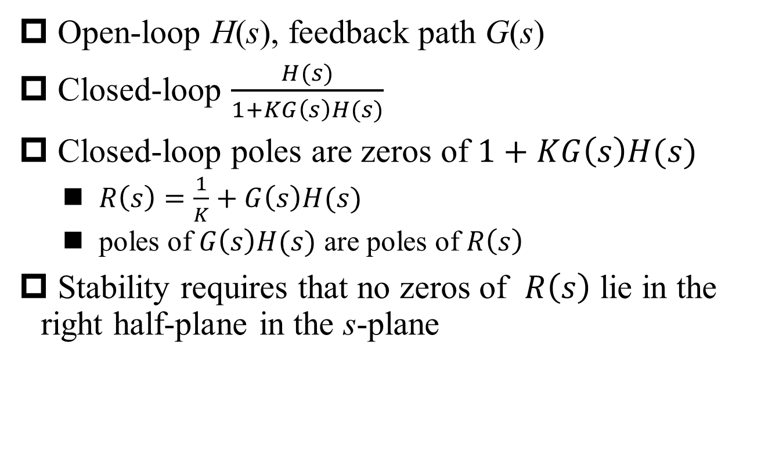
Stability Requirement of CT LTI Feedback Systems
§11.4 Nyquist Stability Criterion
Open-loop H(s), feedback path G(s)
Closed-loop $\frac{H(s)}{1+KG\left(s\right)H(s)}$
Closed-loop poles are zeros of $1+KG\left(s\right)H(s)$
$R\left(s\right)=\frac{1}{K}+G\left(s\right)H(s)$
poles of $G\left(s\right)H(s)$ are poles of $R\left(s\right)$
Stability requires that no zeros of $R\left(s\right)$ lie in the right half-plane in the s-plane

Slide 49
Contour Equivalent to Right Half-Plane
§11.4 Nyquist Stability Criterion
Construct a clockwise closed contour C
When M goes to infinity
the contour C is extended to the right half-plan
the contour C becomes –jM to jM

Slide 50
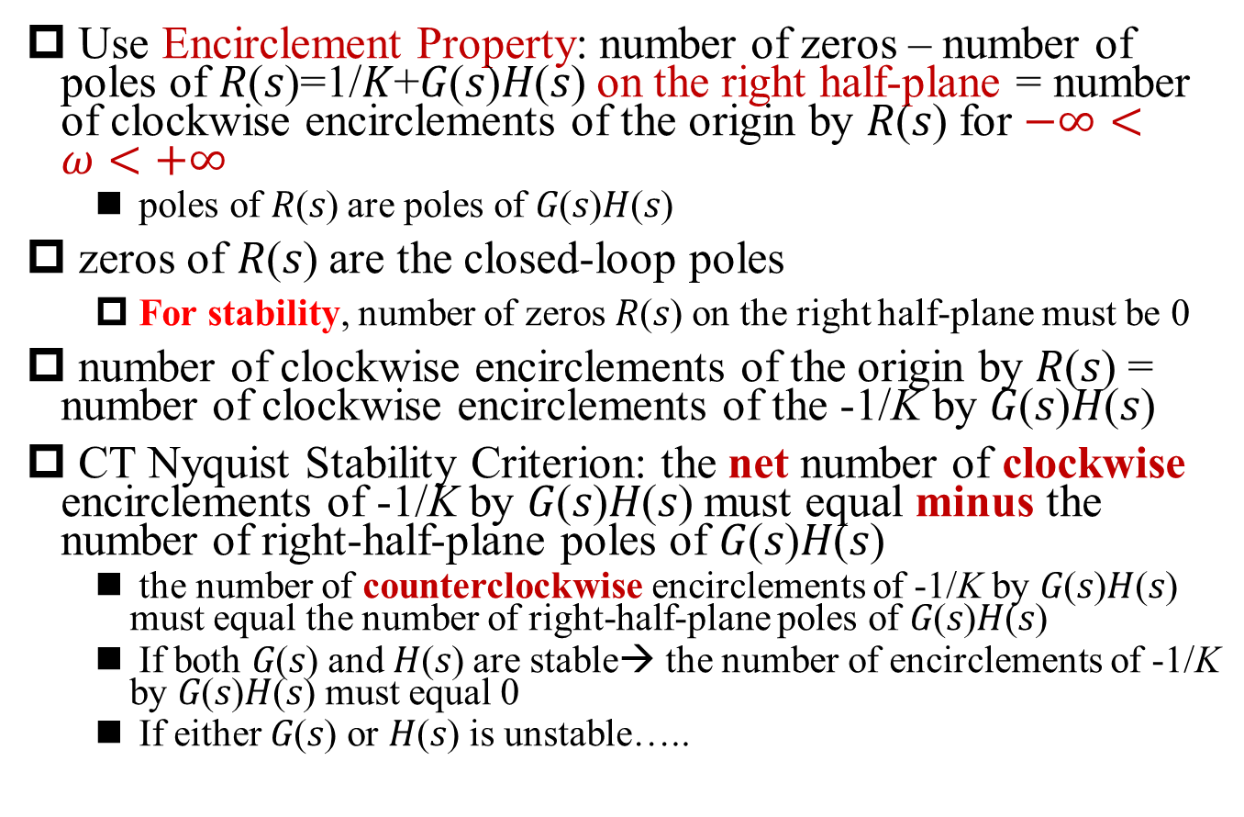
CT Nyquist Stability Criterion
§11.4 Nyquist Stability Criterion
Use Encirclement Property: number of zeros – number of poles of 𝑅(𝑠)=1/𝐾+𝐺(𝑠)𝐻(𝑠) on the right half-plane = number of clockwise encirclements of the origin by 𝑅(𝑠) for $−∞<ω<+∞$
poles of 𝑅(𝑠) are poles of 𝐺(𝑠)𝐻(𝑠)
zeros of 𝑅(𝑠) are the closed-loop poles
For stability, number of zeros 𝑅(𝑠) on the right half-plane must be 0
number of clockwise encirclements of the origin by 𝑅(𝑠) = number of clockwise encirclements of the -1/K by 𝐺(𝑠)𝐻(𝑠)
CT Nyquist Stability Criterion: the net number of clockwise encirclements of -1/K by 𝐺(𝑠)𝐻(𝑠) must equal minus the number of right-half-plane poles of 𝐺(𝑠)𝐻(𝑠)
the number of counterclockwise encirclements of -1/K by 𝐺(𝑠)𝐻(𝑠) must equal the number of right-half-plane poles of 𝐺(𝑠)𝐻(𝑠)
If both 𝐺(𝑠) and 𝐻(𝑠) are stable→ the number of encirclements of -1/K by 𝐺(𝑠)𝐻(𝑠) must equal 0
If either 𝐺(𝑠) or 𝐻(𝑠) is unstable…..
Q1: Why?
Q2: Why?

Slide 51

Example (1) of CT Nyquist Stability Criterion
§11.4 Nyquist Stability Criterion
$G\left(s\right)=\frac{1}{s+1}$, $H(s)=\frac{1}{\frac{1}{2}s+1}$
Both 𝐺(𝑠) and 𝐻(𝑠) are stable→ the number of encirclements of the -1/K by 𝐺(𝑠)𝐻(𝑠) must equal 0
For stability: -1/K≤0 or -1/K>1 → K≥0 or -1<K<0
Nyquist Plot

Slide 52
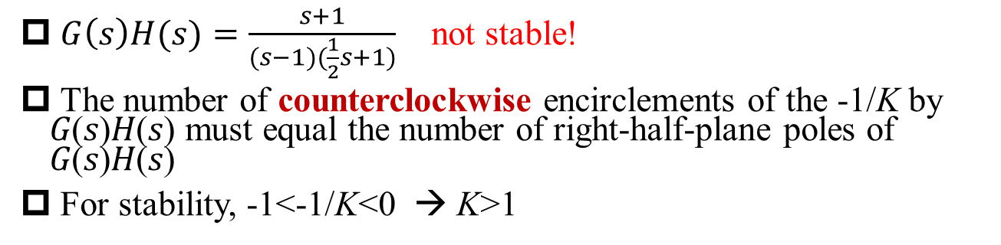
Example (2) of CT Nyquist Stability Criterion
§11.4 Nyquist Stability Criterion
$G\left(s\right)H(s)=\frac{s+1}{(s−1)(\frac{1}{2}s+1)}$ not stable!
The number of counterclockwise encirclements of the -1/K by 𝐺(𝑠)𝐻(𝑠) must equal the number of right-half-plane poles of 𝐺(𝑠)𝐻(𝑠)
For stability, -1<-1/K<0 → K>1

Slide 53
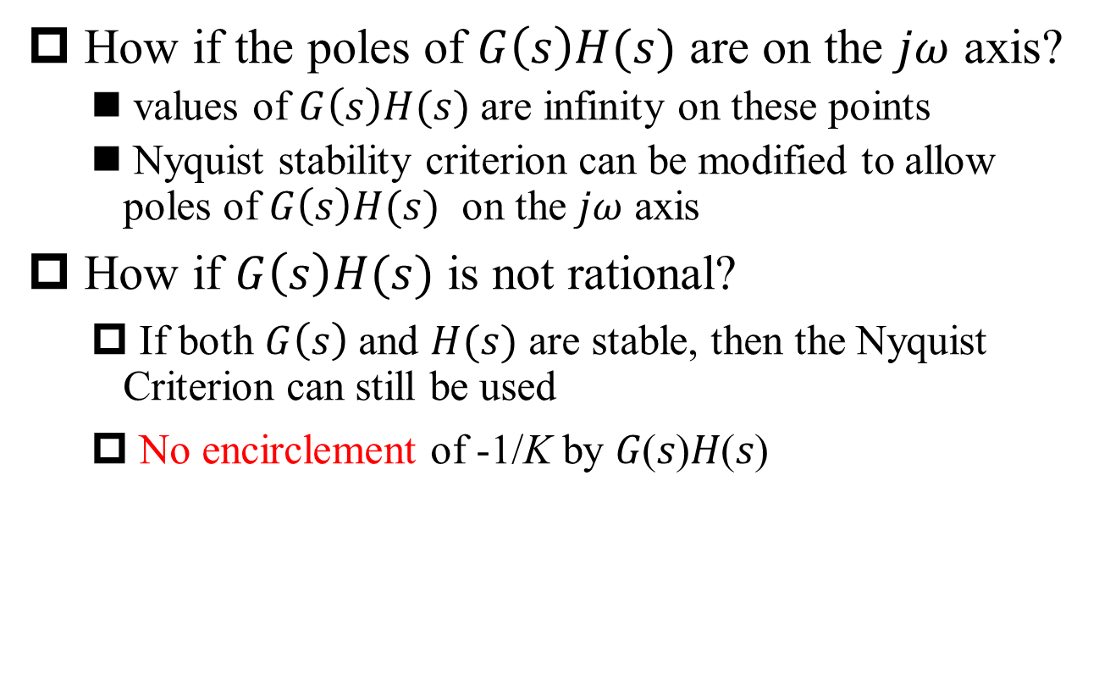
Extra Discussion on Nyquist Stability Criterion
§11.4 Nyquist Stability Criterion
How if the poles of $G\left(s\right)H(s)$ are on the $jω$ axis?
values of $G\left(s\right)H(s)$ are infinity on these points
Nyquist stability criterion can be modified to allow poles of $G\left(s\right)H(s)$ on the $jω$ axis
How if $G\left(s\right)H(s)$ is not rational?
If both $G\left(s\right)$ and $H(s)$ are stable, then the Nyquist Criterion can still be used
No encirclement of -1/K by 𝐺(𝑠)𝐻(𝑠)

Slide 54
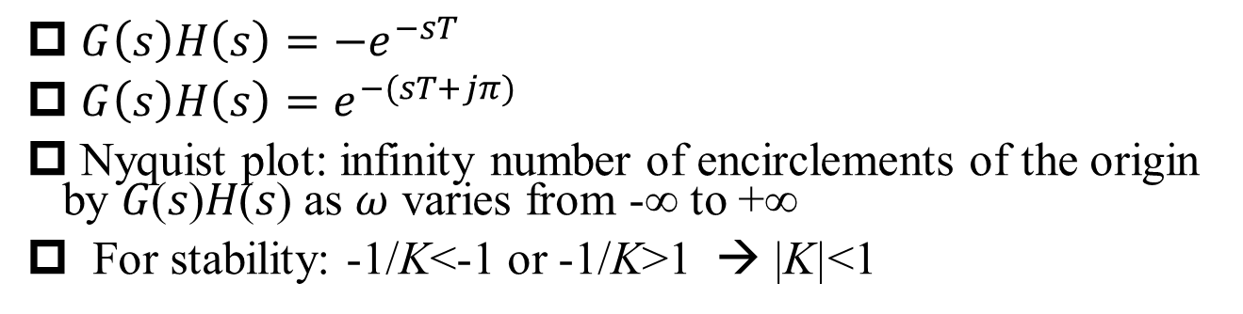
Example (3) of CT Nyquist Stability Criterion
§11.4 Nyquist Stability Criterion
$G\left(s\right)H\left(s\right)=−e^{−sT}$
$G\left(s\right)H\left(s\right)=e^{−(sT+jπ)}$
Nyquist plot: infinity number of encirclements of the origin by 𝐺(𝑠)𝐻(𝑠) as $ω$ varies from -∞ to +∞
For stability: -1/K<-1 or -1/K>1 → |K|<1

Slide 55

DT Nyquist Stability Criterion
§11.4 Nyquist Stability Criterion
For the closed-loop system to be stable, the net number of clockwise encirclements of -1/K by the Nyquist plot of $G\left(e^{jω}\right)H\left(e^{jω}\right)$ must equal minus the number of poles of $G\left(z\right)H\left(z\right)$ that lie outside the unit circle

Slide 56
Gain Margin and Phase Margin
§11.5 Phase and Gain Margins
Gain margin: the minimum additional gain K (φ=0) to make the closed-loop system unstable
Phase margin: the minimum additional phase φ (K=1) to make the closed-loop system unstable

Slide 57
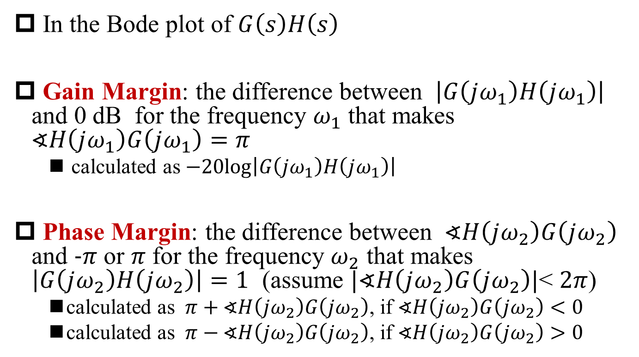
Alternative Definitions of Gain Margin and Phase Margin (Bode Plot)
§11.5 Phase and Gain Margins
In the Bode plot of $G\left(s\right)H\left(s\right)$
Gain Margin: the difference between $\left|G\left(jω_{1}\right)H\left(jω_{1}\right)\right|$ and 0 dB for the frequency $ω_{1}$ that makes $∢H\left(jω_{1}\right)G\left(jω_{1}\right)=π$
calculated as $−20log\left|G\left(jω_{1}\right)H\left(jω_{1}\right)\right|$
Phase Margin: the difference between $∢H\left(jω_{2}\right)G\left(jω_{2}\right)$ and $−π$ or $π$ for the frequency $ω_{2}$ that makes $\left|G\left(jω_{2}\right)H\left(jω_{2}\right)\right|=1$ (assume $|∢H\left(jω_{2}\right)G\left(jω_{2}\right)|$< $2π$)
calculated as $π+∢H\left(jω_{2}\right)G\left(jω_{2}\right)$, if $∢H\left(jω_{2}\right)G\left(jω_{2}\right)<0$
calculated as $π−∢H\left(jω_{2}\right)G\left(jω_{2}\right)$, if $∢H\left(jω_{2}\right)G\left(jω_{2}\right)>0$

Slide 58
Stability Analysis Based on Bode Plot
§11.5 Phase and Gain Margins
Phase Margin=48.92°
Note: extra 180 phase shift with negative feedback

Slide 59
Summary
Advantage of negative feedback
improve linearity and accuracy, stabilization, ….
What’s the cost?
1st order feedback equation
Root locus for stability analysis
Nyquist Criterion for stability analysis
Gain margin/Phase Margin for stability analysis

